Slide 1
Applied Cryptography
By:
Dr. Archana Gupta

Slide 2
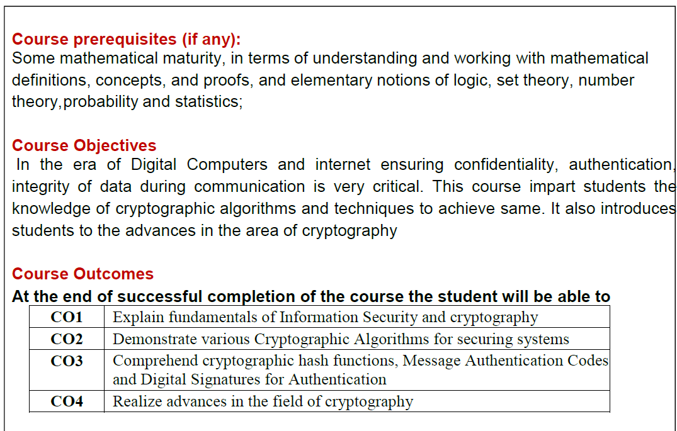

Slide 3
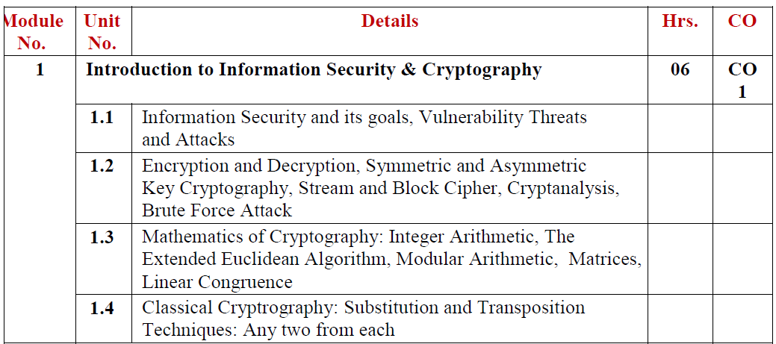

Slide 4
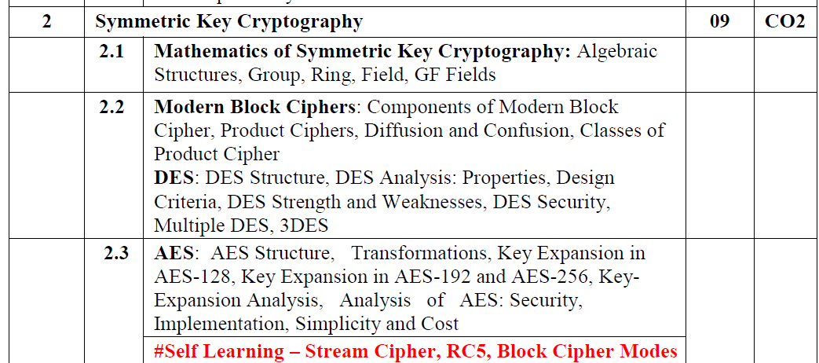

Slide 5
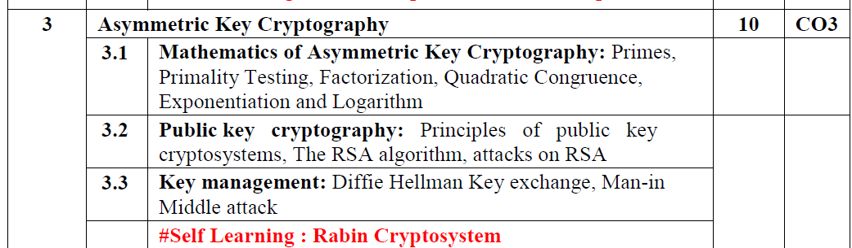

Slide 6
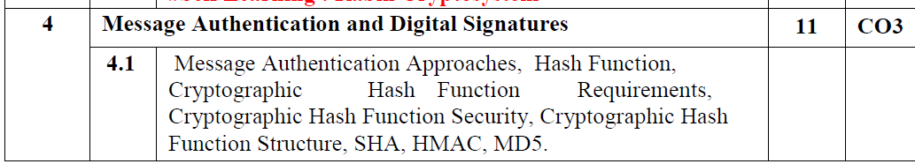
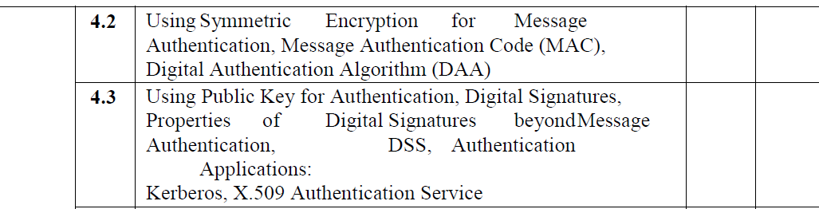

Slide 7
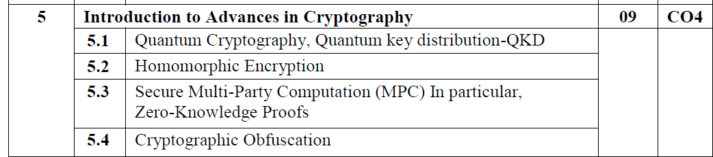

Slide 8
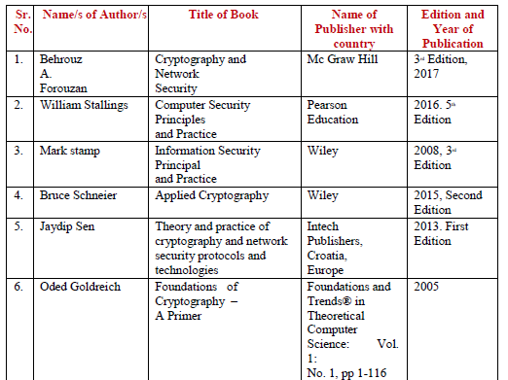

Slide 9
IA
Case study
Protocol design
Implementation
Research study
….

Slide 10
Experiments
Experiment List
Rubrics
Performance
Quality
Submission

